Slide 1
Fundamental Understandings of Models and Data
DSGT 9/9/2019
http://bit.ly/2kAwuFp ; 389270

Slide 2
Goals
Learn several ways to:
Consider machine learning
Consider models
Consider data
Understand the goals of “good” ML/Data Sci?
Put it all together through coding examples!
Notes:
http://sleep.csail.mit.edu/

Slide 3
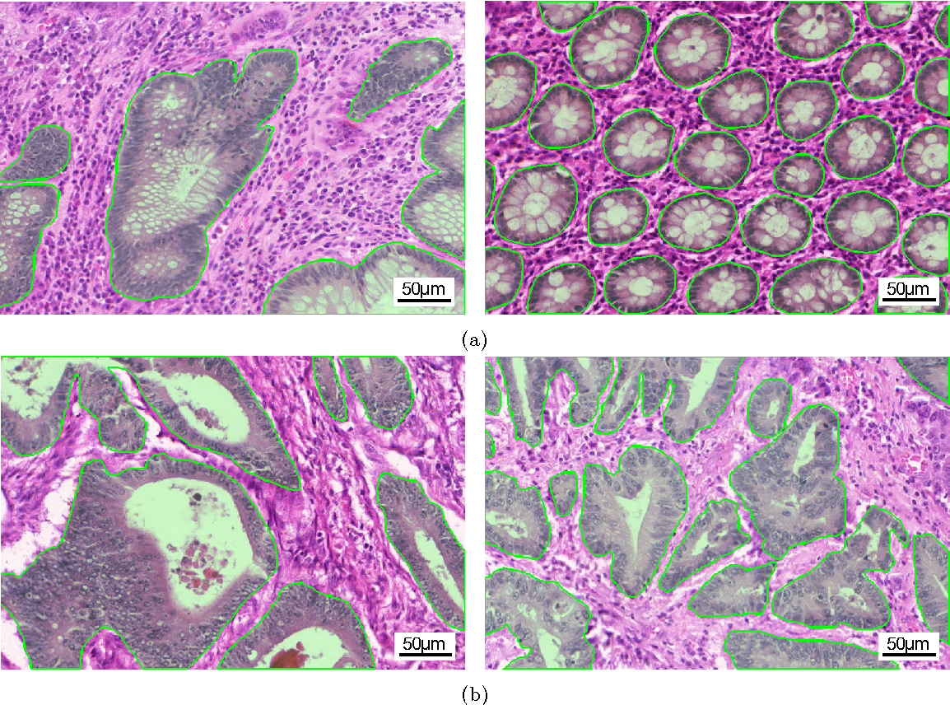
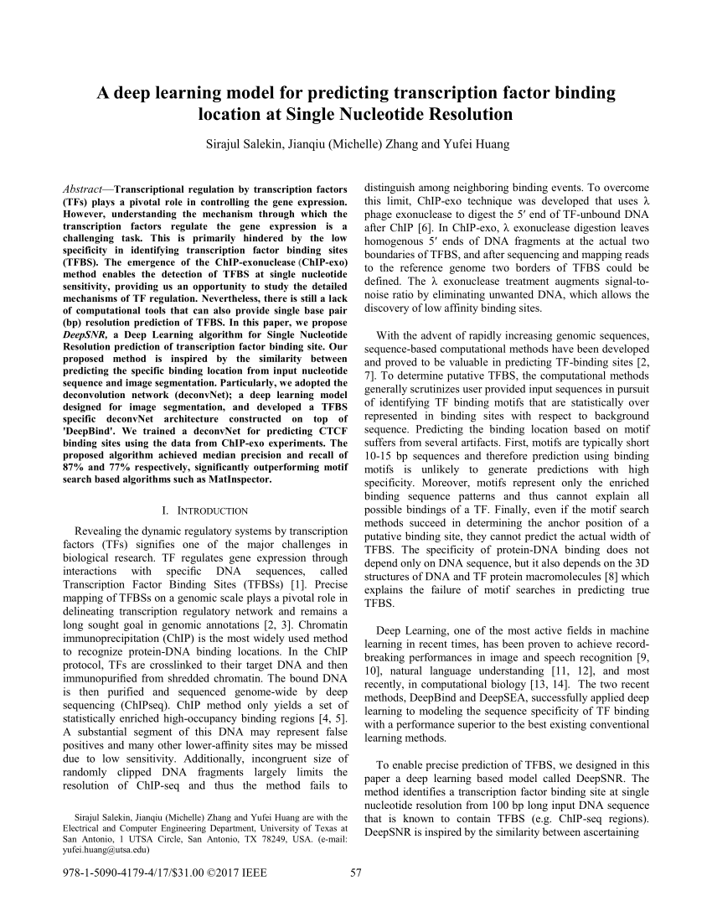

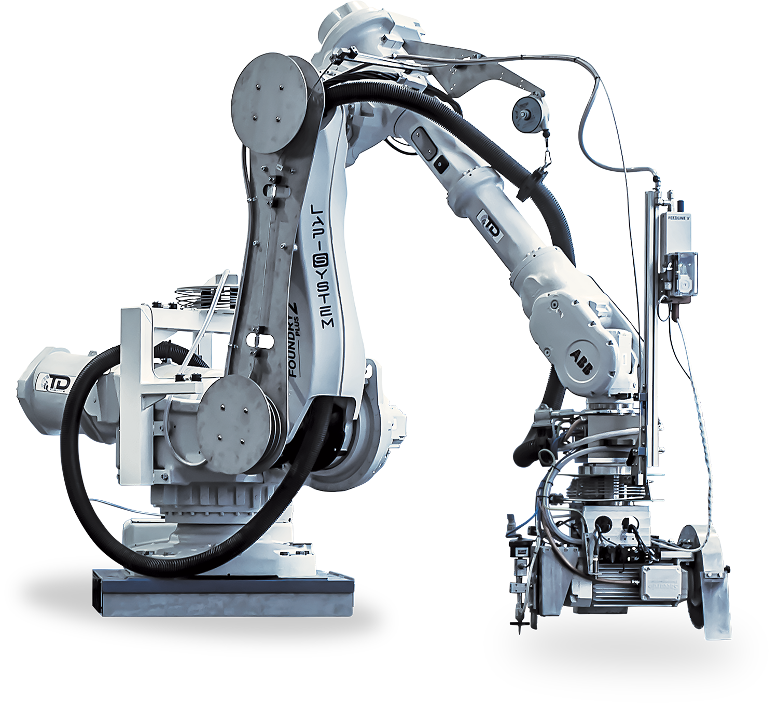


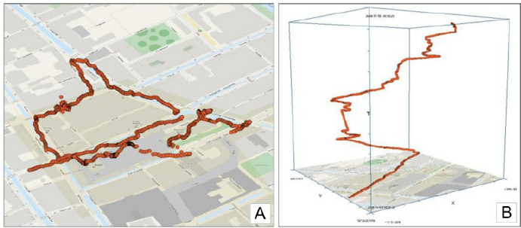
Real-World Applications
Route/trajectory planning
Language translation
Document summarization
Medical scan segmentation
Predictive diagnostic
Malware detection
Robotics and prosthetics
….

Slide 4
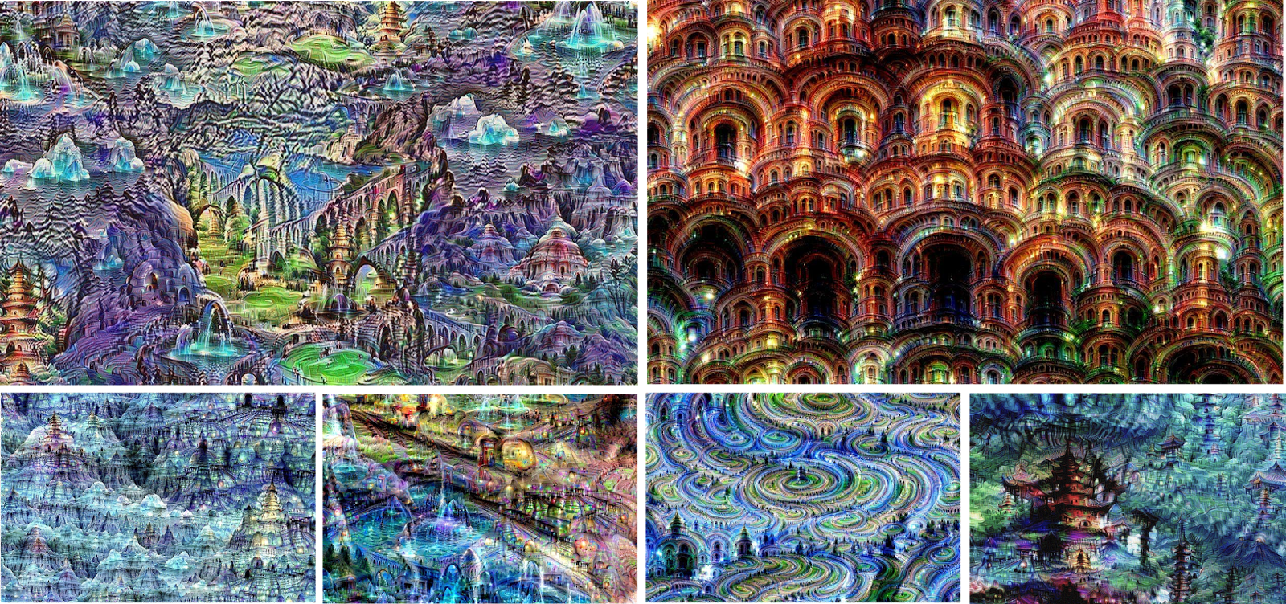
Google Dream

Slide 5
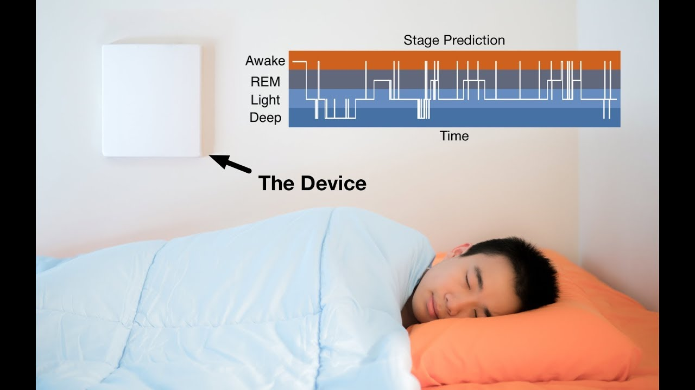
RF-Sleep
Tracking sleep cycles through radio signals
Device emits RF signals.
Reflect off body
Slight body movements detected
Vitals-- pulse. breathing rate, movement
“Learning Sleep Stages from Radio Signals:
A Conditional Adversarial Architecture” (Zhao et. al)
Notes:
http://sleep.csail.mit.edu/

Slide 6
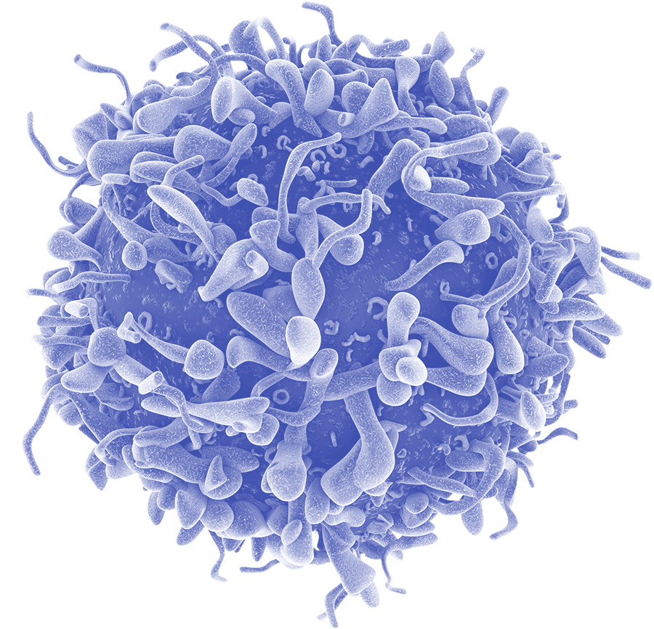


Myth!
Data science, machine learning, deep learning as a magic black box
Black Box
Notes:
This is not a thing!!!

Slide 7


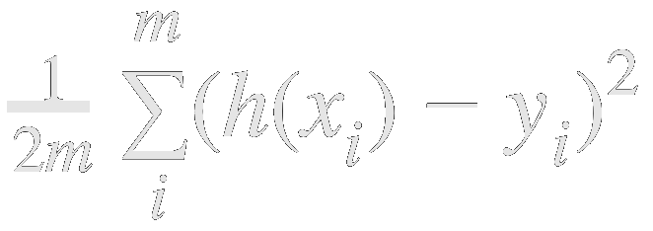

Levels of Mastery
User Level
Available toolkits.
Plug & chug coding
Master Level
Einstein-level math.
Formulations

Slide 8
Levels of Mastery
User Level
Available toolkits.
Plug & chug coding
OUR GOAL: Develop a deep understanding of data and analytical/predictive models while using tools widely used in industry
Us
Master Level
Einstein-level math.
Formulations

Slide 9
What is the relationship between data science and machine learning?

Slide 10
Data Science
Statistics
Conclusions
Actions Predictions
Data
Machine Learning
Domain Knowledge

Slide 11
What is a model?
Mathematical/computational representation of the real world

Slide 12
Three Ways to Consider
Models and Computation
Picture Representation
Decision Boundaries
Mathematical Formulation

Slide 13
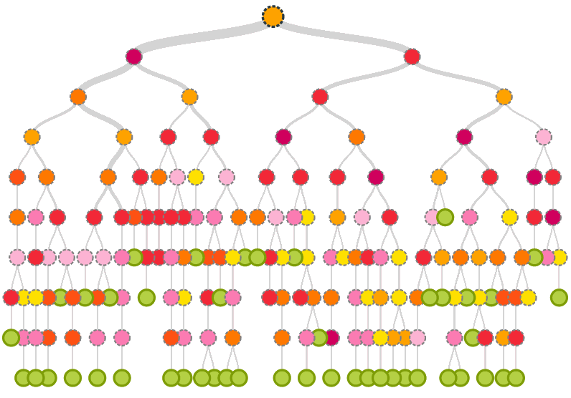
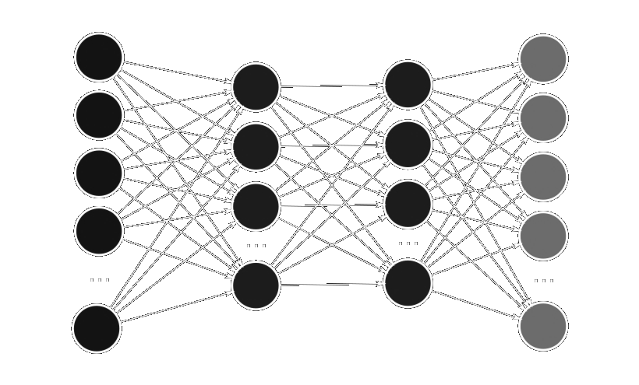
1) Pictorial Representations

Slide 14
2) Decision Boundaries
Logistic Regression
Decision Tree
Neural Network
Notes:
Mention linear and nonlinear

Slide 15
3) Math Formulation
Discover a mapping function representing input output relationships
Example:
y = f(x) + e
f: X → Y
Parameters
Example:
Discover a function representating relationships between inputs and outputs

Slide 16

Mapping
23 | 19 | 38 | 12
12 | 72 | 93 | 20
33 | 62 | 99 | 38
37 | 34 | 22 | 18
84 | 87 | 46 | 37
72 | 92 | 60 | 22
Jellyfish
f: X → Y
Image → Label

Slide 17

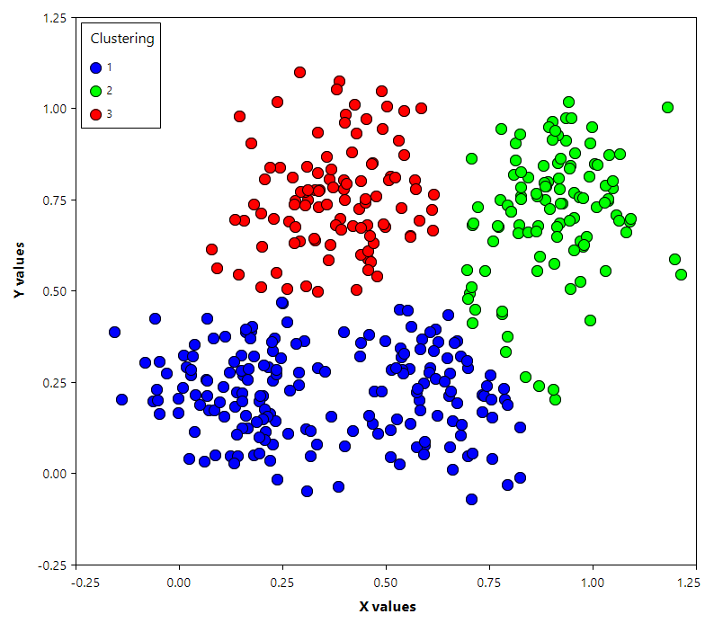
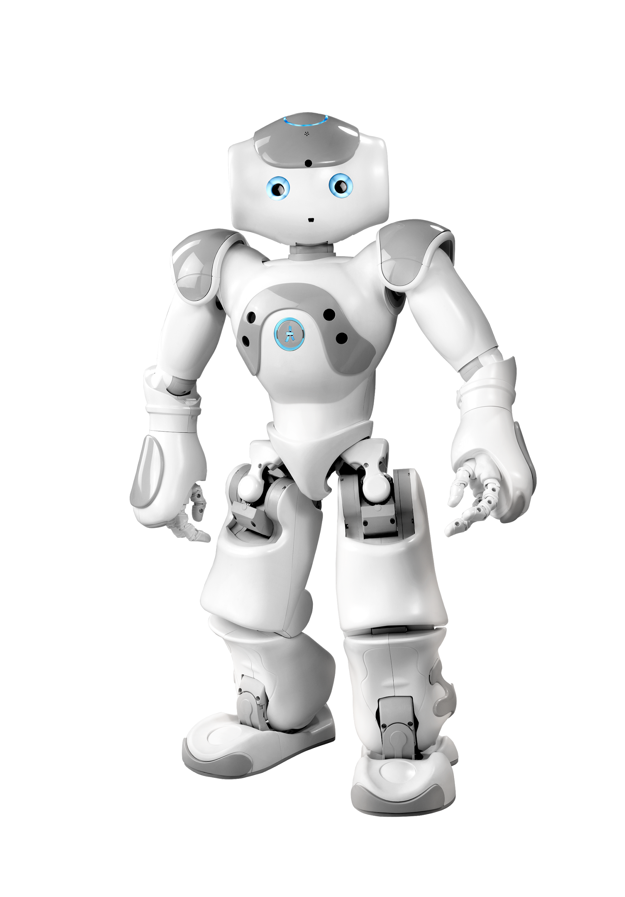
Classes of ML: Input
Supervised Learning
Training labels
Unsupervised learning
No training labels
Reinforcement learning
Decision problem
Uses reward function

Slide 18
Quiz:
What is the difference between classification and regression?
What are example cases?

Slide 19




Classification v. Regression
$200,000
Spam?
9.5/10
Bear?

Slide 20
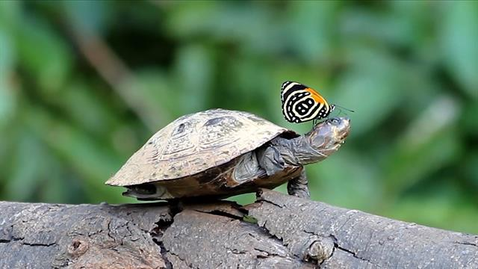
Classifiers: Outputs Types
Binary → yes/no
Multiclass → single output
Multilabel → set of outputs

Slide 21
Classifiers: Outputs Types
Binary → yes/no
Turtle or not turtle
Multiclass → single output
Dog or cat or elephant or turtle?
Multilabel → set of outputs
Turtle? butterfly? Turtle AND butterfly?

Slide 22

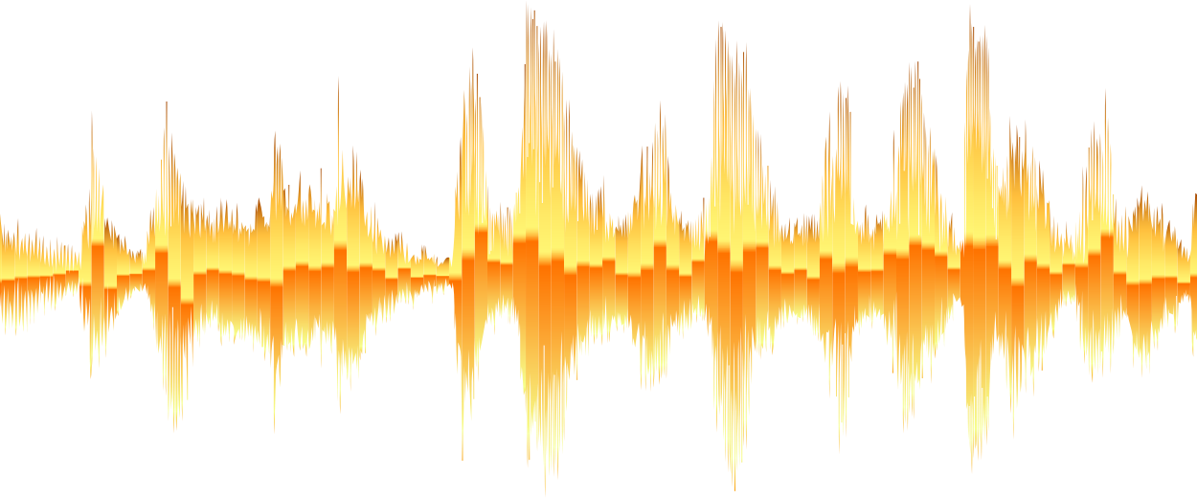
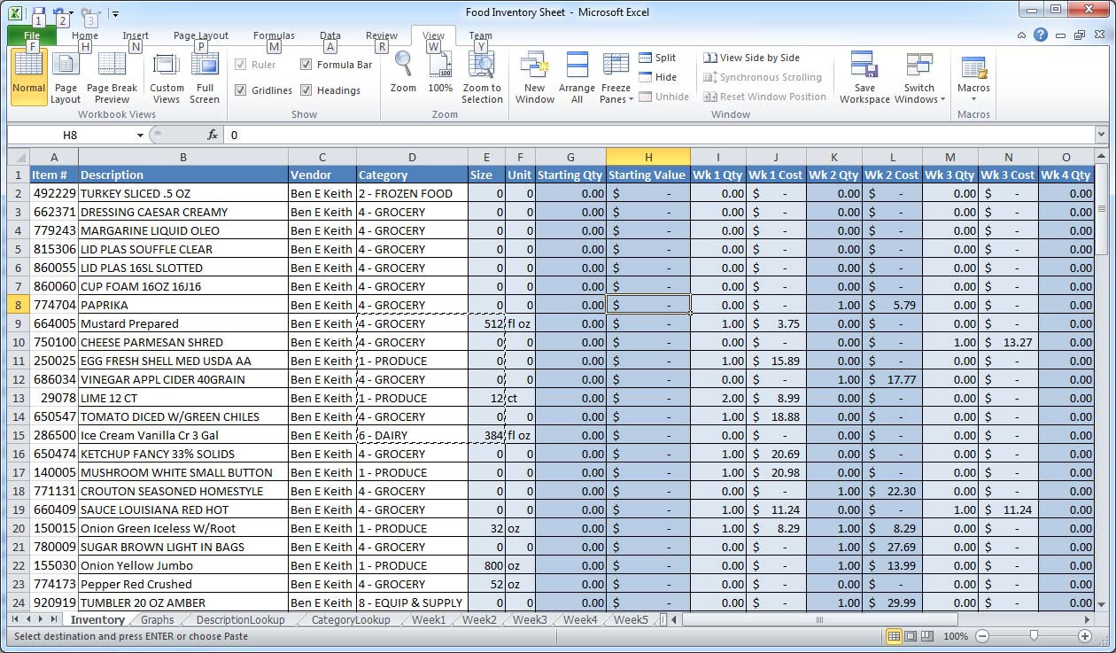
Data
Audial, Visual, Tabular

Slide 23



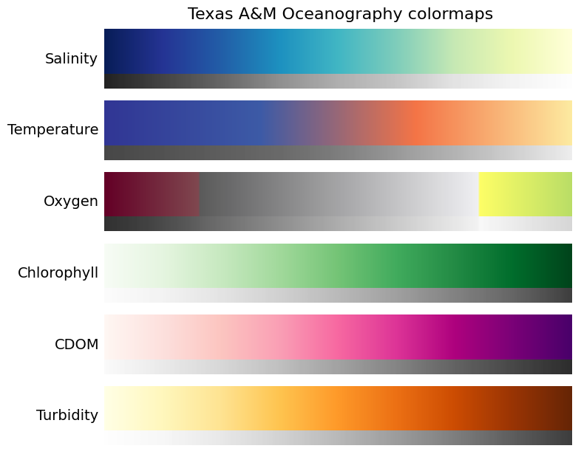


Types of Data
Numerical: Quantitative
Discrete
Continuous
Categorical: Qualitative
Ordinal
Nominal
Input
Input

Slide 24
Dimensionality
Number of FEATURES in data
Potentially 100s-1000’s of features
What happens when performing operations?
Try to make conclusions?
Image :256x256x3 pixels
Health records: 30 measurements/person
 | Feature | Feature | Feature
Expt | 2342.23 | 674.56 | 11234.5
Expt | 1234.13 | 3423.5 | 256.23
Expt | 123.53 | 954.3 | 2345.5
Expt | 43345.3 | 847.34 | 763.432
Expt | 34598.5 | 845.5 | 4365.4
Expt | 8564.3 | 743.2 | 9765.3
Expt | 54634.3 | 1345.3 | 98623.4

Slide 25
Linearity
Separability by hyperplane
Informs model type

Slide 26

Linearity: Model
What type of data supported?
Consider pictorially, w/ decision boundaries, mathematically

Slide 27
Goal of DataSci
Given features, derive conclusions
 | Feature | Feature | Feature
Expt | 2342.23 | 674.56 | 11234.5
Expt | 1234.13 | 3423.5 | 256.23
Expt | 123.53 | 954.3 | 2345.5
Expt | 43345.3 | 847.34 | 763.432
Expt | 34598.5 | 845.5 | 4365.4
Expt | 8564.3 | 743.2 | 9765.3
Expt | 54634.3 | 1345.3 | 98623.4
Regression
Classification

Slide 28
MINIMIZE YOUR ERROR!

Slide 29
But how do we make a “good” prediction?
Train until you reach a high accuracy
Minimize your error!

Slide 30
Categorizing models
Convex - Single, unique solution
Non-convex - Multiple possible solutions
f(x) = x^2
f(x) = x^4 + x^3 -2x^2-2x
Notes:
Parametric vs. Non-parametric
A "parametric" model has parameters that do not explicitly depend on or include the input points. The polynomial regression model is an example of a parametric model. The number of parameters is fixed with respect to the number of data points.
A "non-parametric" model includes some parameters or hyperparameters that are defined on the domain of the independent variable and depend on the inputs. A spline model is an example of a local model. The number of parameters in the model varies with the number of data points.
Nonparametric models are generally excellent for interpolation, but fail miseraly for extrapolation, while parametric models are less accurate for interpolation but provide more reasonable extrapolations. Nonparametric models tend to have many more parameters, and proper optimization of model complexity can lead to similar performance for both types.

Slide 31
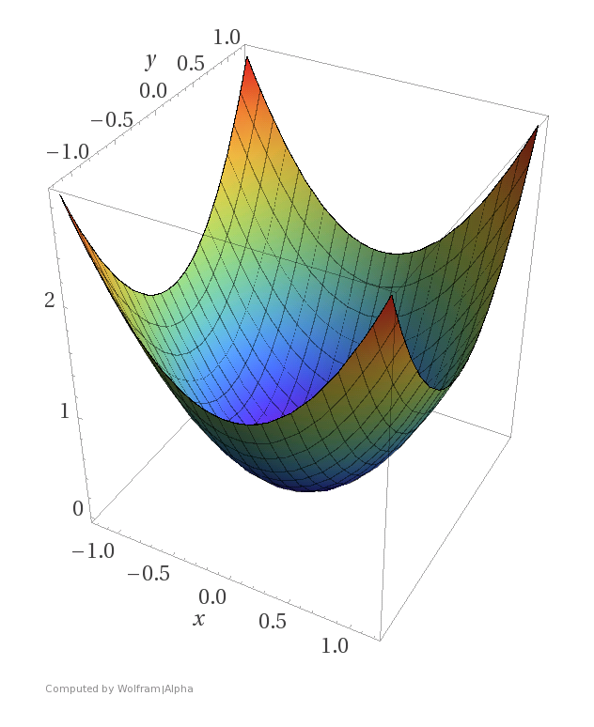
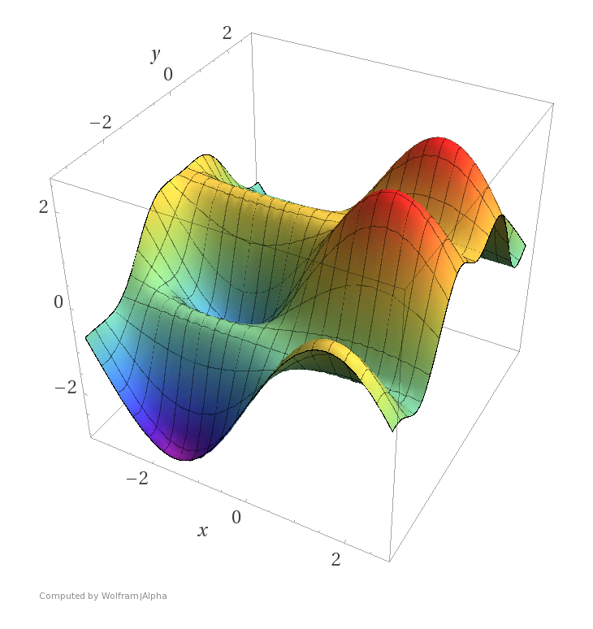
Categorizing models
Convex - Single, unique solution
Non-convex - Multiple possible solutions
Notes:
Parametric vs. Non-parametric
A "parametric" model has parameters that do not explicitly depend on or include the input points. The polynomial regression model is an example of a parametric model. The number of parameters is fixed with respect to the number of data points.
A "non-parametric" model includes some parameters or hyperparameters that are defined on the domain of the independent variable and depend on the inputs. A spline model is an example of a local model. The number of parameters in the model varies with the number of data points.
Nonparametric models are generally excellent for interpolation, but fail miseraly for extrapolation, while parametric models are less accurate for interpolation but provide more reasonable extrapolations. Nonparametric models tend to have many more parameters, and proper optimization of model complexity can lead to similar performance for both types.

Slide 32
Generalization
Preprocess: Process/Analyze incoming data
Train: Feed through a model
Select coefficients/parameters
Minimize an error
Test: Deploy to real world
Goal: Generalization
How well did your model perform in the real world?

Slide 33

Generalization
Train
Test

Slide 34
Under/Overfitting
How well the model UNDERSTANDS the data
Quiz: Which has the best generalization?
Underfit
Overfit

Slide 35
Under/Overfitting
Causes for overfitting
Insufficient amount of sufficient training data
Too many features
Too complex of a model
Memorizing! :(

Slide 36
Countering Overfitting
Causes for overfitting
Insufficient amount of sufficient training data -- more data
Too many features -- data cleaning
Too complex of a model -- regularization and hyperparameters

Slide 37
Conclusion
We can now understand:
Defining goal of ML/Data Sci
Conceptualize a model 3 ways
Pictorially
Decision boundaries
Formulaically
Classification/regression
Supervised/Unsupervised/ Reinforcement Learning
Regression/Classification
Linearity
Parametric vs nonparametric
Convex vs non convex
Types of data
Discrete vs Continuous data
Dimensionality
Generalization
Overfitting vs Underfitting
Counteracting overfitting

Slide 38
Questions?

